Slide 1
AERIAL CAMERA NETWORK FOR OBSERVING MOVING TARGETS
REVATHY SURENDRAN
CLASS NO:51, S7 BTECH CSE
24 OCTOBER 2018

Slide 2
CONTENTS
AERIAL CAMERA NETWORK FOR OBSERVING MOVING TARGETS
INTRODUCTION
APPLICATIONS
EXISTING APPROACHES
PROPOSED METHOD
PROBLEM FORMULATION
QUAD-TREE BASED SPACE DISCRETIZATION
COOPERATIVE MOVEMENT OF AERIAL CAMERAS
CONCLUSION
REFERENCES

Slide 3
INTRODUCTION
AERIAL CAMERA NETWORK FOR OBSERVING MOVING TARGETS
OBJECTIVE: To observe multiple moving targets on the ground

Slide 4
APPLICATIONS
AERIAL CAMERA NETWORK FOR OBSERVING MOVING TARGETS
Surveillance tasks
Sports
Crowd and social movement monitoring
Wildlife research
Disaster management

Slide 5
EXISTING APPROACHES
AERIAL CAMERA NETWORK FOR OBSERVING MOVING TARGETS
CMOMMT
A-CMOMMT
P-CMOMMT
B-CMOMMT
CMOMMT using ACN

Slide 6
PROPOSED METHOD
AERIAL CAMERA NETWORK FOR OBSERVING MOVING TARGETS
Decentralised and cooperative motion planning of aerial camera network
ACN observe targets from different elevation
Objective: maximize duration and quality of observation
Uses quad tree data structure
Uses artificial forces to avoid collisions in ACN

Slide 7


PROBLEM FORMULATION
AERIAL CAMERA NETWORK FOR OBSERVING MOVING TARGETS
Region Ὠ
G={G1,G2,…,GB} set of B targets
State of ith target at time step t is denoted as
C={C1,C2,…,CA} set of A aerial cameras
State of jth camera at time step t is denoted by

Slide 8

AERIAL CAMERA
AERIAL CAMERA NETWORK FOR OBSERVING MOVING TARGETS
Quad copter equipped with
Downward looking camera
Position sensor
Wireless communication unit
Computing unit

Slide 9


PROBLEM FORMULATION(Contd.)
AERIAL CAMERA NETWORK FOR OBSERVING MOVING TARGETS
The expression of observation is
Objective function :
: Total time of mission

Slide 10
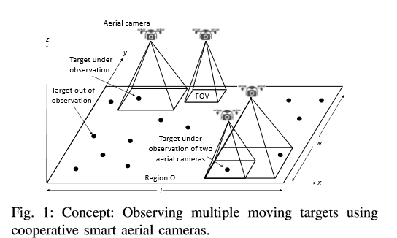
PROPOSED METHOD (contd.)
AERIAL CAMERA NETWORK FOR OBSERVING MOVING TARGETS
https://ieeexplore.ieee.org/document/8396250/
Courtesy:

Slide 11
QUAD TREE DATA STRUCTURE
AERIAL CAMERA NETWORK FOR OBSERVING MOVING TARGETS
Each node has at most 4 children
Construction:
1. Divide space into 4 boxes
2.If a box contain more than one point in it create a child for it
3.If no points are found do not create child for it
4.Recurse for each children

Slide 12
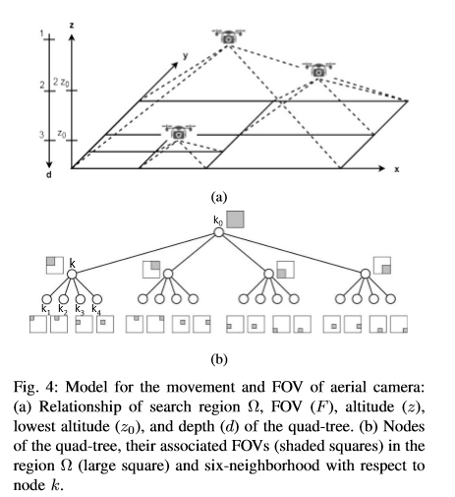
KEY PURPOSE OF QUAD TREE
AERIAL CAMERA NETWORK FOR OBSERVING MOVING TARGETS

Slide 13

KEY PURPOSE OF QUAD TREE(Contd.)
AERIAL CAMERA NETWORK FOR OBSERVING MOVING TARGETS
Model discrete movement decisions of aerial cameras
Variations in the FOVs and quality of observation
Best quality of observation of target G ͭͭᵢ

Slide 14
COOPERATIVE MOVEMENT OF AERIAL CAMERAS
AERIAL CAMERA NETWORK FOR OBSERVING MOVING TARGETS
Maximize the number of targets under high quality observation
Avoid collision of aerial cameras
Discourage movement of camera to higher altitudes

Slide 15

COOPERATIVE MOVEMENT OF AERIAL CAMERAS(Contd.)
AERIAL CAMERA NETWORK FOR OBSERVING MOVING TARGETS

Slide 16
ARTIFICIAL FORCES ON QUAD TREE
AERIAL CAMERA NETWORK FOR OBSERVING MOVING TARGETS
Mechanism for cooperative motion of cameras
Combination of attractive force and repulsive force
Free nodes generate attractive force
Occupied nodes generate repulsive force

Slide 17


ATTRACTIVE FORCE
AERIAL CAMERA NETWORK FOR OBSERVING MOVING TARGETS
Increases with increase in number of targets visible from it
Quality of observation of target affects the attractive force
Ijs attractive force at node k contributed by target i

Slide 18
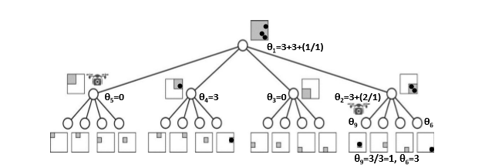
ATTRACTIVE FORCE (Contd.)
AERIAL CAMERA NETWORK FOR OBSERVING MOVING TARGETS
i

Slide 19

REPULSIVE FORCE
AERIAL CAMERA NETWORK FOR OBSERVING MOVING TARGETS
Avoid collisions among cameras
Inversely proportional to Euclidian distance between node and location of camera

Slide 20
MOVEMENT ON QUAD TREE
AERIAL CAMERA NETWORK FOR OBSERVING MOVING TARGETS
Uses token passing protocol
Camera updates its quad tree only when it receives token
Movement decision completed pass the token

Slide 21
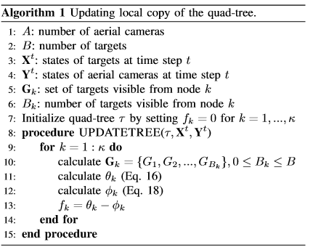
MOVEMENT ON QUAD TREE (Contd.)
AERIAL CAMERA NETWORK FOR OBSERVING MOVING TARGETS

Slide 22
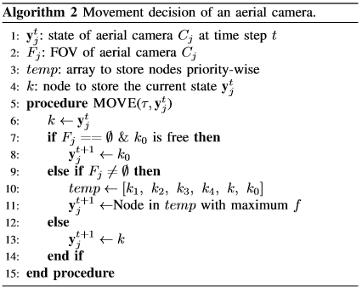
MOVEMENT ON QUAD TREE (Contd.)
AERIAL CAMERA NETWORK FOR OBSERVING MOVING TARGETS

Slide 23
MOVEMENT ON QUAD TREE (Contd.)
AERIAL CAMERA NETWORK FOR OBSERVING MOVING TARGETS
If 2 nodes have same force, then prioritise
If nodes are in same level first in anti-clockwise direction is chosen

Slide 24
MOVEMENT ON QUAD TREE (Contd.)
AERIAL CAMERA NETWORK FOR OBSERVING MOVING TARGETS
Complexity of algorithm 1 is
Complexity of algorithms depend on number of nodes in quad tree
Complexity of algorithm 2 is

Slide 25
CONCLUSIONS
AERIAL CAMERA NETWORK FOR OBSERVING MOVING TARGETS
Quad-tree based distributed and cooperative movement strategy
Maximize collective time and quality of observation
Dynamic assignment of locations and FOVs to cameras
Quality of observation depends on levels of elevation

Slide 26
REFERNCES
AERIAL CAMERA NETWORK FOR OBSERVING MOVING TARGETS
L.E. Parker and B. A. Emmons, “Cooperative multi-robot observation of multiple moving targets,” in Proc. of the IEEE International Conference on Robotics and Automation, 1997, pp. 2082-2089.
R. P. Anderson and D. Milutinovic, “A Stochastic Approach to Dubins Vehicle Tracking Problems,” IEEE Transactions on Automatic Control, vol.59, no. 10,pp. 2801-2806, 2014.
L.E. Parker, “Distributed Algorithms for Multi-Robot Observation of Multiple Moving Targets”, Autonomous Robots, vol. 12, pp. 231-255, 2002

Slide 27
REFERENCES
AERIAL CAMERA NETWORK FOR OBSERVING MOVING TARGETS
A. Kolling and S. Carpin, “Cooperative observation of multiple moving targets: an algorithm and its formulization,” The International Journal of Robotics Research, vol. 26, no. 9, pp. 935-953, 2007
P. Alberto, C. Pablo, P. Victor, and S. A. Juan, “Ground vehicle detection through aerial images taken by UAV,” Proc. of IEEE International Conference on Information Fusion(FUSION), 2014, pp. 1-6.
B.B. Werger and M.J Mataric, “Broadcast of Local Eligibility for Multi-Target Observation”, Distributed autonomous Robotic Systems 4, pp. 347-356, 2000

Slide 28
AERIAL CAMERA NETWORK FOR OBSERVING MOVING TARGETS
THANK YOU

